Slide 1

Career Growth & Salary Trends: A Global Industry Analysis

Slide 2
Overview
Analyzing global salary trends across industries to uncover high-paying job roles and career growth opportunities.

Slide 3
Dataset Overview
This dataset encompasses key attributes such as job titles, salaries, industries, experience levels, and demographics, offering valuable insights into global career and compensation trends.

Slide 4

Data Cleaning and Preprocessing
Removing Unwanted Columns
Standardize Data Types
Handling Missing Values
Check for Outliers

Slide 5
Data Analysis Using MySQL
MySQL allows for efficient querying, data manipulation and the extraction of meaningful insights to drive informed decision-making.

Slide 6

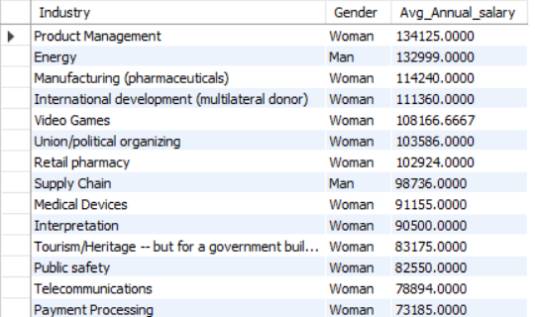
Average Salary by Industry and Gender

Slide 7
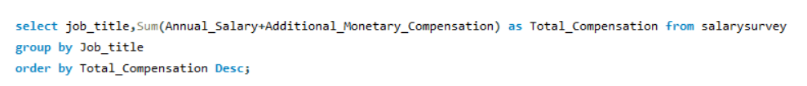
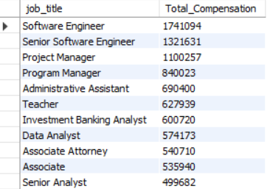
Total Salary Compensation by Job Title

Slide 8
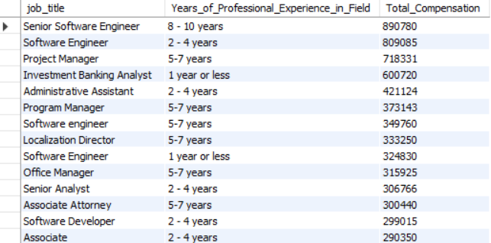
Total Compensation by Job Title and Years of Experience

Slide 9
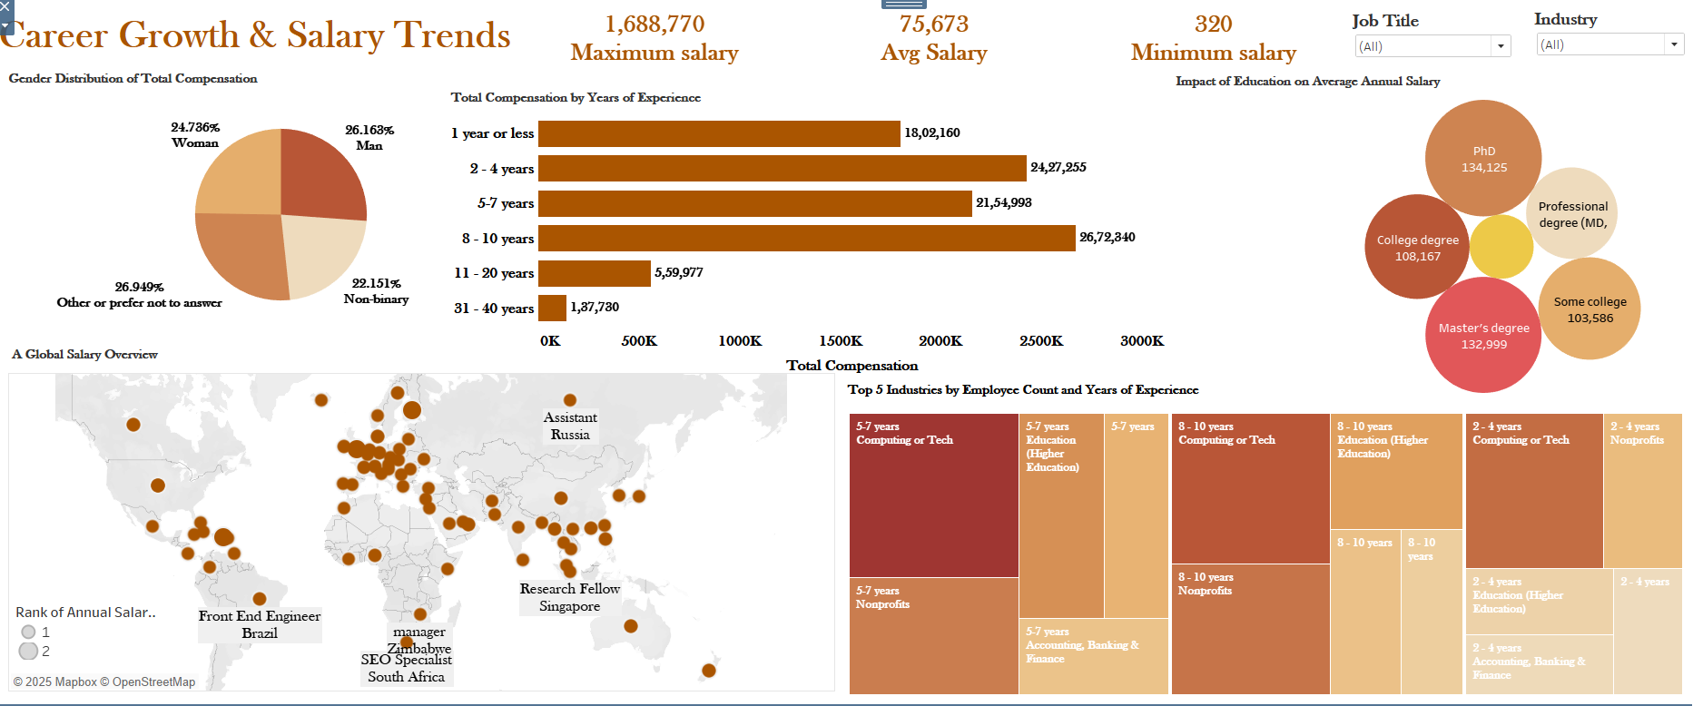
Dashboard

Slide 10
Key Insights
Higher education levels generally lead to higher salaries, but the impact varies across industries, emphasizing the importance of industry selection in career growth and salary potential.
The Computing or Tech industry dominates across all experience levels, showcasing strong talent retention and career growth.
Gender-based disparities in additional monetary compensation highlight potential inequities in salary structures, with non-binary individuals receiving the least, emphasizing the need for transparent and inclusive pay policies for equitable career growth.
Higher education generally leads to better average salaries, but industry demand and experience can sometimes outweigh formal degrees in determining career growth and earning potential.
Total compensation peaks between 2-7 years of experience, highlighting rapid early-career growth, while earnings decline after 10+ years, emphasizing the need for strategic career progression.

Slide 11
Conclusion
Career growth and salary trends show that early to mid-career professionals experience the highest earning potential, while long-term success depends on skill development, strategic role transitions and industry demand.

